Slide 1
Research project: 3D scanning based estimating the center of gravity of the body
supervised by Tianfang Lin, Prof Stefan Gumhold
Notes:
Hello,everyone.I appreciate the opportunity to be with you today. I am Boyang Liu, a computer science master student. I am here to give the presentation of my research project.The topic is “3D scanning based estimating the center of gravity of the body” I am honored to be advised by Tianfang Lin and Prof Stefan Gumhold.

Slide 2
overview
1.Motivation
2.Related work
3.Introduction
4.Implementation
5.Demo
6.Further work
Notes:
My presentation is divided into six main sections. Firstly I will give a short introduction of the motivation and related work. secondly, I wil give the workflow of my project. Then I‘ll detail the methods I’ve used in the project and their results, including failed attempts. At the end we will watch a five minutes demo video of my program.And I will talk about the further work.

Slide 3
1.Motivation

Slide 4
MOtivation
Estimating human pose is an essential task for teaching skills of Internet. Estimating center of mass will be a kickoff point for human pose estimation.
Existed pose estimation methods capture human skeleton in real time. But there is no solution for diverse human figures. 3D scanning provides a potential to describe a detailed human figure.
As multiple kinect azure can be connected to one pc, scanning a 3D human model by multiple RGB-D cameras become possible.
Notes:
1 2 para
Conceptually, 3D scanning and 3d reconstruction are independent fields. In recent years more and more researchers have focused on combining 3D scanning and surface reconstruction using an RGBD camera for tracking and static object reconstruction. With the advent of the Azure Kinect sensor from Microsoft, scanning a 3D human model by multiple RGB-D cameras has become possible.

Slide 5
2.Related work

Slide 6
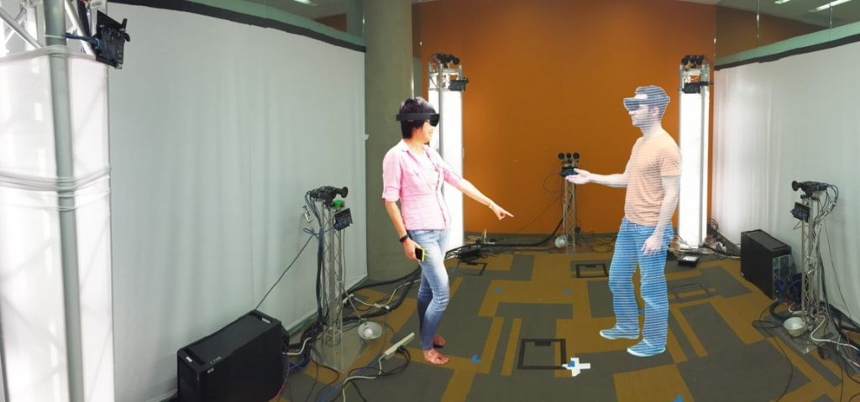
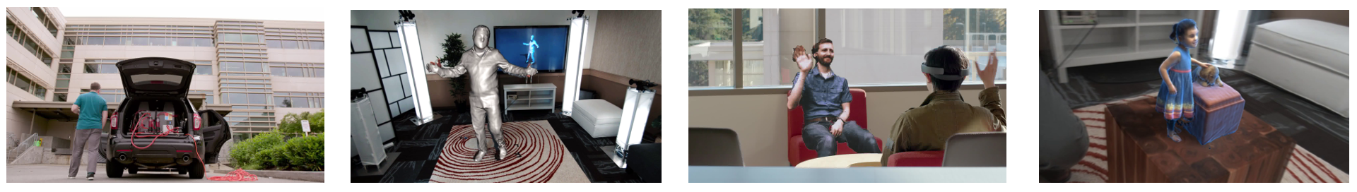
Related work
Microsoft Holoportation
Notes:
Microsoft in 2016 showed an application scenario for the augmented reality glasses Hololens. Which is called “holoportation”, In this project, cameras capture the person and then the data is transmitted to the HoloLens interlocutor. This allows users wearing augmented reality displays to see, hear and interact with remote participants in 3D, almost as if they were present in the same physical space.

Slide 7
3.Introduction

Slide 8
Introduction
What is 3D scanning?
3D scanning is the process of analyzing a real-world object or environment to collect data on its shape and possibly its appearance . The collected data can then be used to construct digital 3D models.
Basic idea:
The working area is observed by 3 RGB-D cameras. Using these rgba and depth images we estimate the camera positions and reconstruct an occupancy map of object . The goal of the project is to use this occupancy map to estimate the center of human body in real time in VR.

Slide 9
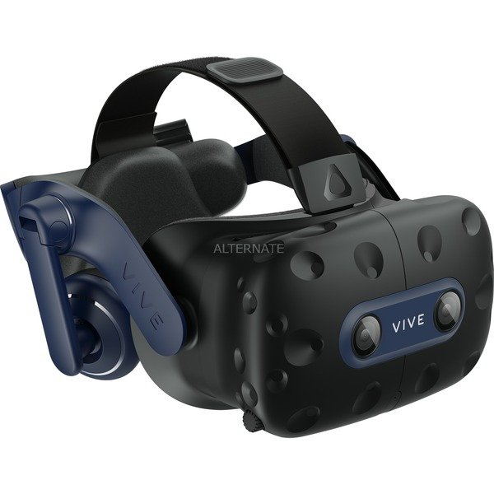
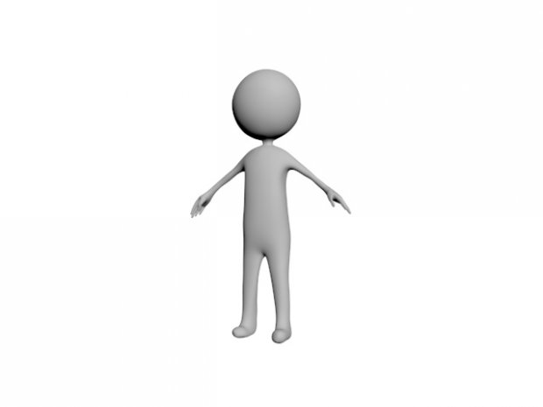
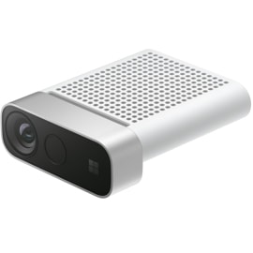

Introduction
Workflow:
RGB and Depth images
Point cloud
GPGPU
Volume
The center of gravity of the human body
Dense mesh
Notes:
Here is the workflow of my project. We can see one human standing in front of cameras in the left part. The work area is a 2m*2m*2m bounding box. When wearing a VR helmet, the user can see the virtual human in the 3d coordinate in real-time. On the right is the format in which the data is processed. RGB and Depth streams from cameras as the input can be constructed as point clouds. Voxelized point clouds can be converted to volumes and meshes on general-purpose GPU. The voxels of the object can also be used to estimate the center of gravity of the human body.

Slide 10
Introduction
Task description:
Basic Tasks:
1. attach a tracker on each kinect camera, obtain initial pose by multiple sampling at the beginning.
2. select a fixed area by using VR controller interactively, e.g. one person needs a space of 2*2*2 = 8 cubic meters. This step is mainly used to remove the background and unwanted area, so that we don't have to reconstruct and render too much data.
3. registering 3D scans into a global coordinate system in the fixed area.
4. remove outliers(there may be some outliers, so we need to add this step)
5. volume reconstruction
6. estimate center of gravity by using the mesh
7. draw the trajectory of the center of gravity in VR
8. the visualization of the center of gravity in VR
Optional Tasks:
1. reconstruct surface by using fusion method/ online surface reconstruction(use compute shader)
2. record and replay the 3D model
3. evaluate the center of gravity
4. the recording and replay of the reconstructed mesh and center of gravity trajectory
Notes:
The task description has 8 Basic Tasks
and 4 Optional Tasks.I construct my workflow based on these tasks.

Slide 11
3.environment

Slide 12
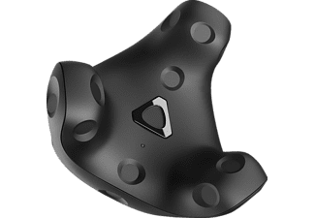
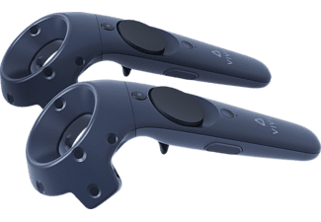
Environment
3 Auzre Kinects
HTC VIVE
cgv framework
Notes:
3 Auzre Kinects and one vr device with one vr tracker and 2 vr controllers are used in project. I develop my program based on the rgbd-develop branch of cgv framework.

Slide 13
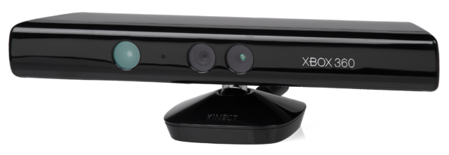
Why choose kinect azure?
Kinect for Windows V1
Azure Kinect
One computer can link only one Kinect V1
Users can synchronize multiple Azure Kinect DK devices
Notes:
Now we have a question:
Why choose kinect azure?
We know in the kinect fusion system the scene is scanned by a kinect v1.but the limitation is that One computer can link only one Kinect V1. So using Kinect V1 we can not do the reconstruction of complete human body in realtime.
But Users can synchronize multiple Azure Kinect devices on one computer.
Azure kinect supports up to eight devices working on one computer at the same time.
The limitation of azure kienct is that the images have distortion because of the 120-degree wide-angle lens.
The Aszure kienct SDK offers the related function to construct point cloud.But unfortunately that function is not open source.As a result the traditional tsdf algorithm can not be implemented in my project becase we cannot do the back projection from camera coordinate to image.
I will also talk about this problem later.

Slide 14
4.implementation

Slide 15
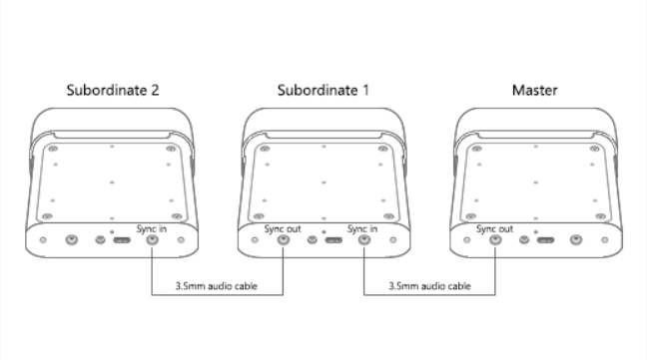
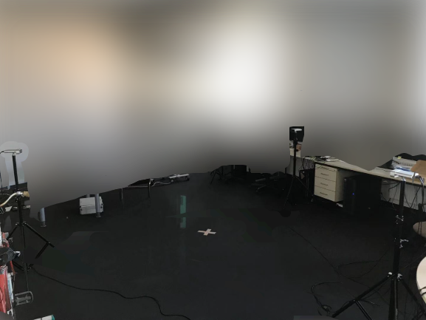
point cloud registration:
1.link and configure multiple cameras
Cameras are placed in the labor and linked to the computer as shown in the images.
Users can define the color and depth stream format in the GUI.
Notes:
The first step is linking and configuring multiple cameras.
Cameras are placed in the labor and linked to the computer as shown in the pictures.
Users can define the color and depth stream format in the GUI.

Slide 16
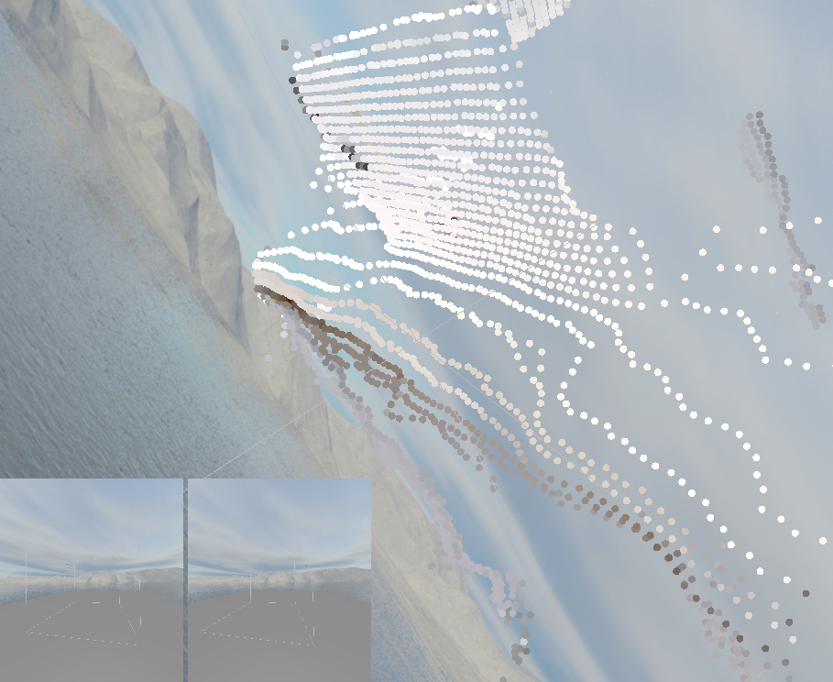
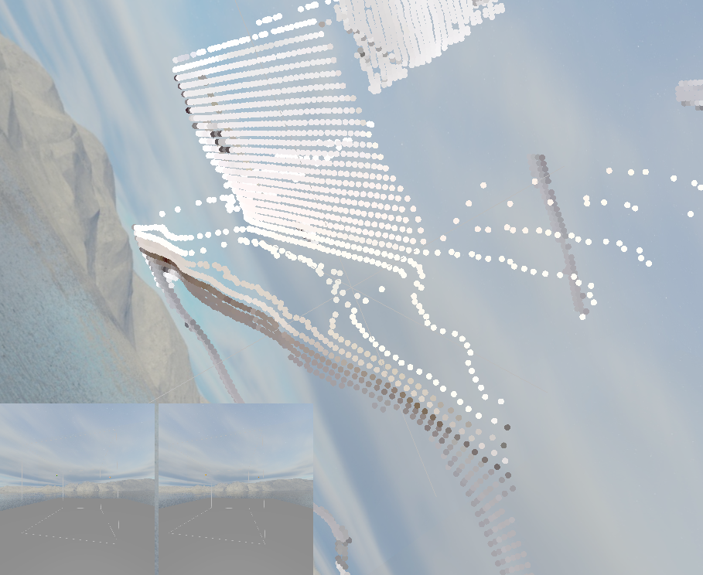
point cloud registration:
Bilateral filtering of Depth images
before
after
Limitation:
Low efficiency: The point cloud cannot be generated in real time.
Notes:
I have implemented the Bilateral filtering of Depth images to get the point cloud with better quality.I give up this method because its Low efficiency. Using it the point cloud cannot be generated in real time.

Slide 17
point cloud registration:
physical world
camera coordinate
global coordinate in VR
The goal of the registration:
Getting rotation matrix and translation vector in order to do transformation of point cloud and cameras
Notes:
The point clouds can be directly generated from kinect azure sdks using k4a_calibration_2d_to_3d functions.
But the point clouds are unregistrated.
Here I give the map. The point cloud from images is the obsevation of physical world. They are in the camera coordinate. We need to do the registration to combine these point cloud in global coordinate in VR .

Slide 18
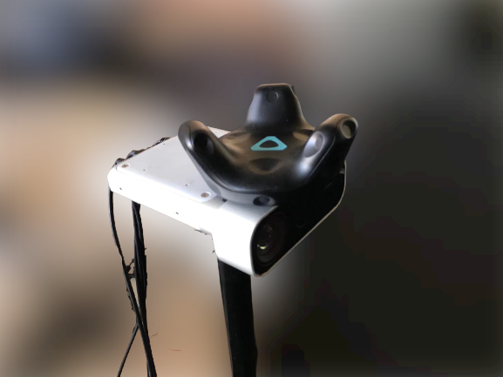
point cloud registration:
2.1Coarse registration:
Tracker is placed on each camera to get the approximate positions of camera in 3D coordinates
Rotation matrix and translation vector are applied to each point.
coarse_t = tracker_pos;
coarse_r =tracker_rotation;
p₁= coarse_r * p₀ + coarse_t;
Error
y
x
y
x
z
z
Notes:
The point cloud registration is devides into 2 steps: coarse registration and fine registration.
I do the coarse registration by placing a tracker on the camera to get the approximate position.
The result doesn’t need to be precise and has about 2 centimeters error in general.
The direction of ray of the tracekr in cgv is changed .

Slide 19
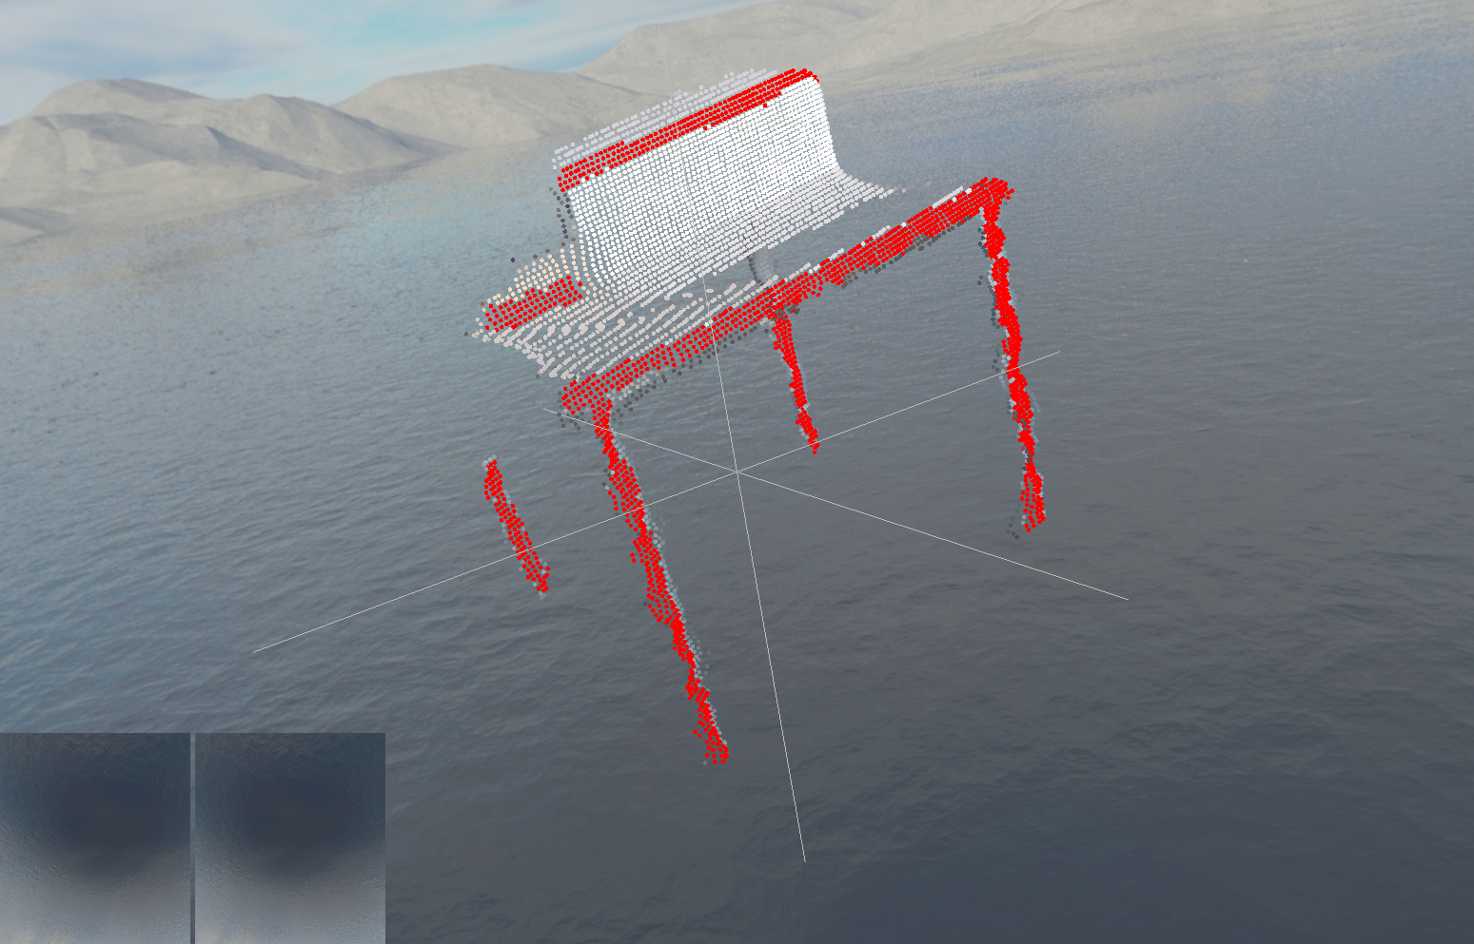
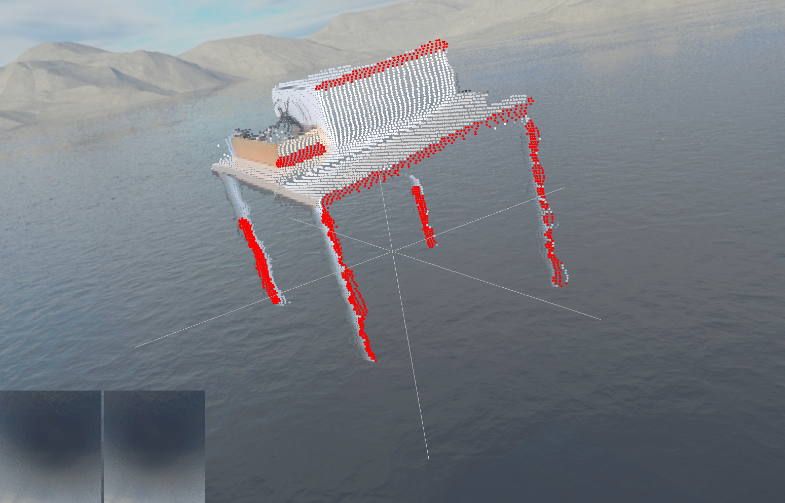
point cloud registration:
2.2Fine registration:
record one static frame and set bounding box for one object to do fine registration
Method 1 :ICP algorithm
The ICP algorithm aims at finding the transformation between a point cloud and another point cloud (or some reference surface ), by minimizing the square errors between the corresponding entities.
Notes:
Fine Registration is an essential component of many computer graphics and computer vision systems. With recent technological advances in RGBD sensors (color plus depth), an active area of research is in techniques combining color, geometry, and learnt priors for robust real-time registration.
I have tried 4 methods for fine registration. The first is ICP algorithm.
The ICP algorithm aims at finding the transformation between a point cloud and another point, by minimizing the square errors between the corresponding entities.

Slide 20
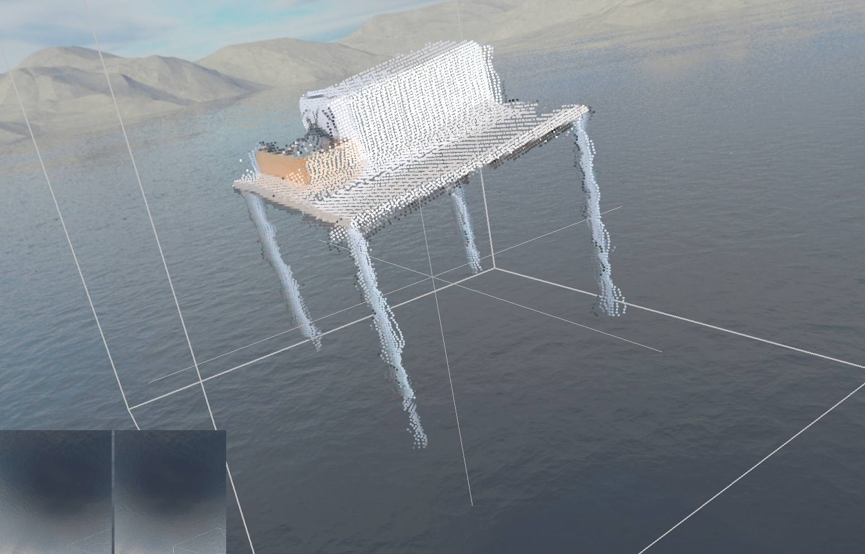
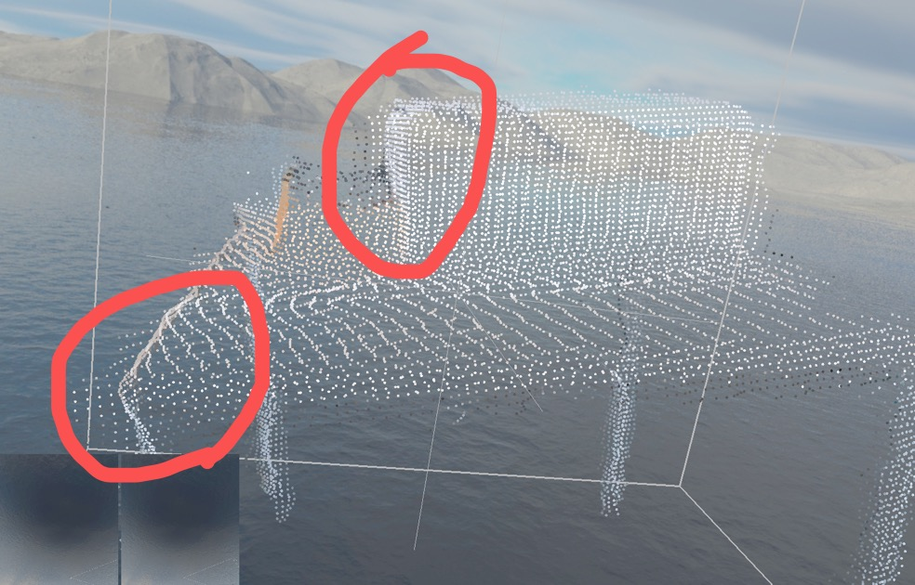
point cloud registration:
result
details
Limitation:
1.Precision depends on the corresponding points selected by the user
2.Local optimum
Notes:
The result is shown in the left image.The limitations are that Precision depends on the corresponding points selected by the user and The result may be a local optimum.

Slide 21
point cloud registration:
Method 2 :Global ICP algorithm
The Go-ICP method is based on a branch-and-bound (BnB) scheme that searches the entire 3D motion space SE(3). By exploiting the special structure of SE(3) geometry, it derives novel upper and lower bounds for the registration error function.
Advantage:
local optima can be avoided.
Disadvantage:
corresponding points are needed.
Notes:
Then I have tried Global ICP algorithm.It has the same result as Icp algorithm.

Slide 22
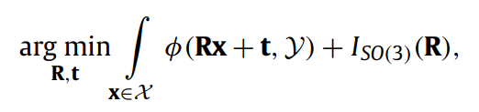
point cloud registration:
Method 3: Sparse ICP algorithm
The introduction of sparse p-norms to increase robustness in the rigid alignment optimization results in a localized change to the classic ICP formulation.
ϕ measures the distance to Y.
In ICP it uses l₂norm.
In SICP it uses l_{p}norm,0≤p≤1
R is restricted to the special orthogonal group SO(3) using the indicator function ISO(3)(X), which evaluates to zero when X ∈ SO(3) and to +∞ otherwise, enforcing the rigidity of the transformation
Notes:
Sparse ICP algorithm is a good way to avoid local optimum. The introduction of sparse p-norms to increase robustness in the rigid alignment optimization results in a localized change to the classic ICP formulation.

Slide 23
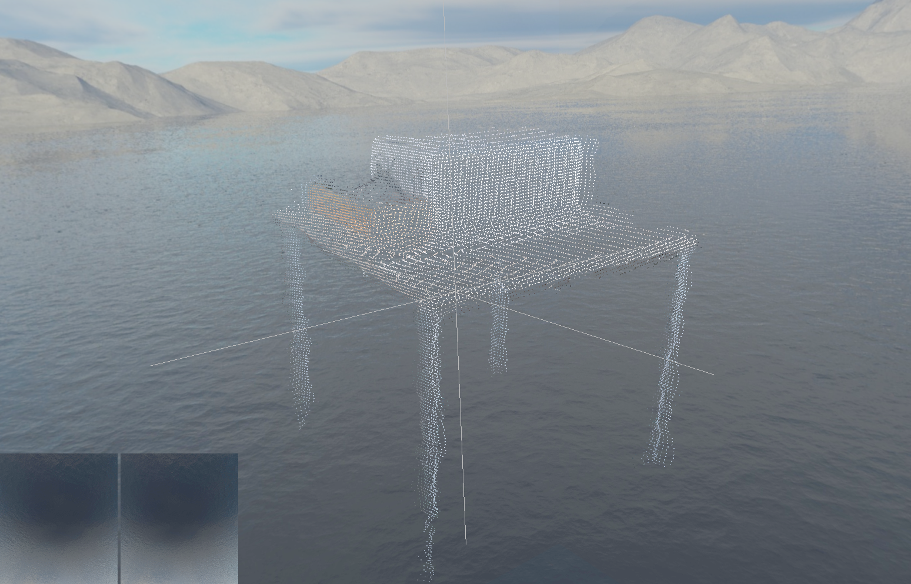
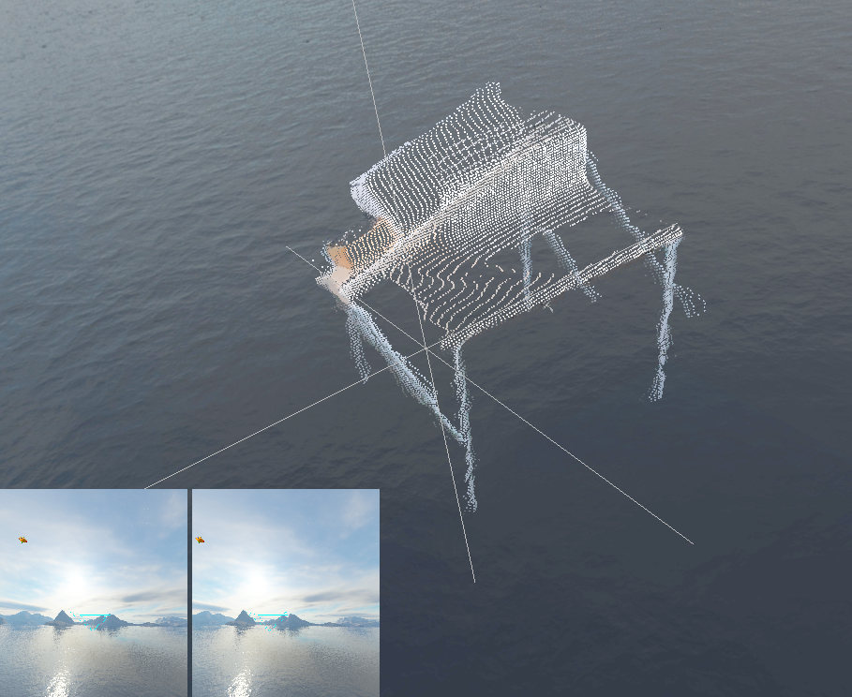
point cloud registration:
p=0.5
p=0.4
Limitation:
Different values of parameter p will affect the results. while implementing ,it hard to guess the paramenter p.
Anvantage:
The result does not depend on the corresponding points manually selected by the user.
Notes:
The left image is the result of sicp with parameter p of value of 0.5. In the right image with value of 0.4
Although the precision can be better than icp algorithm, different values of parameter p will affect the results. while implementing ,it hard to guess the paramenter p.

Slide 24
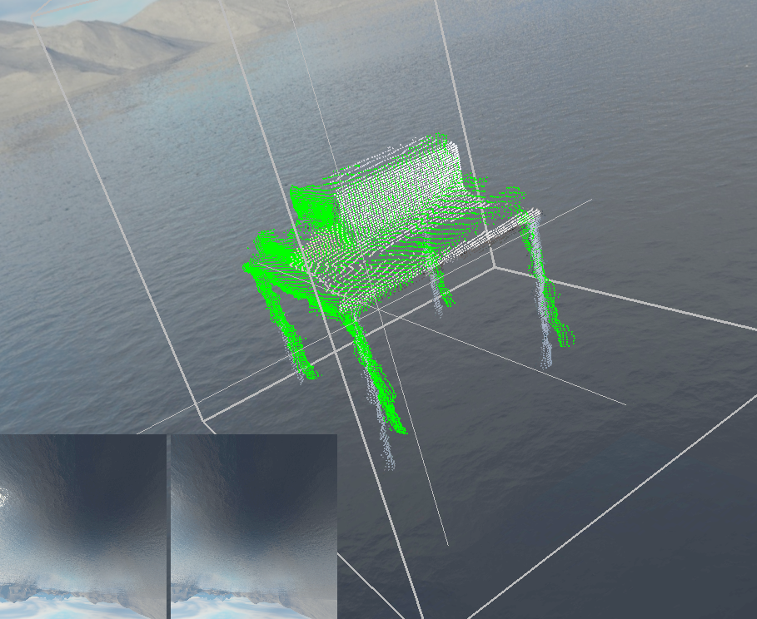
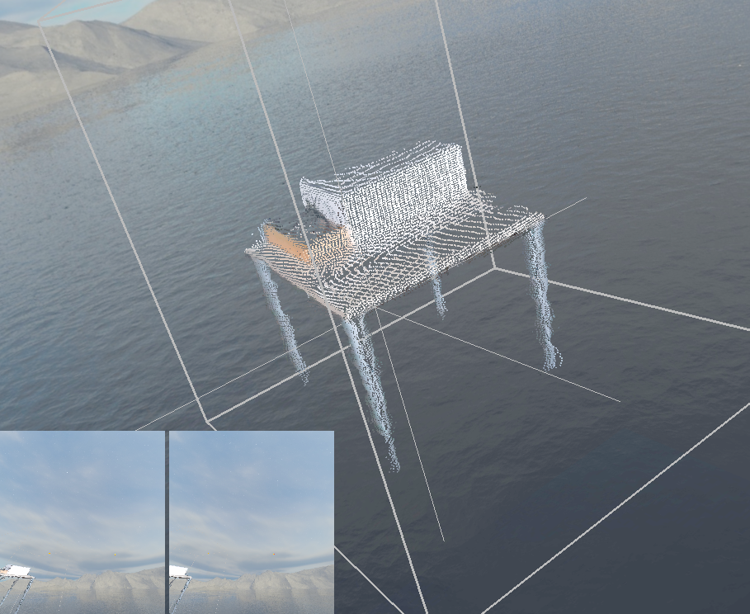
point cloud registration:
Method 4: Manual correction using VR controllers
Use the controller to drag point cloud:
manual_t = controllerRotation * manual_t - controllerRotation * last_controllerpos + new_controllerpos;
manual_r = controllerRotation * manual_r;
P_{new} = manual_r * P + manual_t;
Notes:
Finally I decided to use the Manual correction using controller to do the fine registration.
There is a difference between the tracker and controller for registration.
For tracker, the camera position is the tracker‘s position. The camera direction is the tracker‘s direction. But here we need to use controller to drag the point cloud. So the translation is the new position minus the old position.And the fomulas are as follows.
In practice the manual correction performs well but may cost much time. But it only needs one time when the use run the program, because we don’t need to move cameras any more. You will see the process in the video later.

Slide 25
Voxelization:
Top view of BBox
The silhouette-voxels(blue and grey) of the obeject are the voxels where the point cloud is located.
Perspective view of BBox
Notes:
The next step is the voxelization. The left side is the Perspective view of BBox
and the right is the top view.
At first we need to get the silhouette-voxels of the obeject,which are the blue and grey cubes.
They are the voxels where the point cloud is located.
This is the preliminary work .
Then we do the object filling.
We check all the voxels in the bounding box in parallel.
You can see now the orange voxel is the current voxel. We link the center of voxel to all cameras to get three rays and follow each ray to check if it goes through the silhouette-voxel.
In this case you can see three rays go through three silhouette-voxels. Then it should be marked as inside the object.

Slide 26
Voxelization:
Top view of BBox
Perspective view of BBox
Notes:
In the second case, the orange voxel is determined to be outside the object. Because one ray doesn’t meet the silhouette-voxels unitl it goes outside the bbox.

Slide 27
Voxelization:
Top view of BBox
Perspective view of BBox
Notes:
And here is the result of object filling. Now we get a complete scanned object in the bbox.

Slide 28
4.1Voxelization:
Pseudo-Code in filling.glcs:
for each voxel do:
if the current voxel’ mark is 0:
link the center of current voxel to three cameras.
for each ray do:
find next voxel along the ray until it goes outside the bbox
if the next cube’s mark is 1 :
break;
if all three rays find the voxel with mark’1’
mark the current voxel as ‘1’
else
mark the current voxel as ‘0’
Mark 0: empty voxel
Mark 1: a part of the sacnned object

Slide 29
Voxel based denoising
Top view of BBox
e.g. Operator size is 3
Threshold is 4.
The current voxel is filtered because the sum of Marks value in the operator is 2 which is smaller than threshold
Notes:
Here is the method of denoising.
We also need to check all voxels in parallel.
we can see that the current voxel is orange. Now we define an operator.
I give an example in the left side. The Operator size is 3 means for current voxel we need to check all its 26 adjacent voxels.The threshold here is of value of 4.
The current voxel is filtered because the sum of mark value in the operator is 2 which is smaller than the threshold.
This method is very similar to the image denoising in the computer vision.
And I call it “Voxel based denoising for volume”

Slide 30
Voxel based denoising
Top view of BBox
e.g. Operator size is of the value of 3
The threshold is 4.
The current voxel is kept because the value is 18 which is larger than threshold
Notes:
And in the second case , the orange voxel is kept because the value is 18 which is larger than threshold.
The threshold is 4.

Slide 31
4.1Voxelization:
Pseudo-Code in denoise.glcs and remove_outlier.glcs:
for each voxel do:
if the current voxel’ mark is 1:
if the sum of all adjacent voxels‘ marks within the operator size is greater than threshold
mark the current voxel as ‘1’
else
mark the current voxel as ‘0’
Mark 0: empty voxel
Mark 1: a part of the sacnned object

Slide 32
Mesh generation: Marching cubes
The current gridpoint is marked as 1(orange vertices) if all its 8 adjacent voxels‘ marks are 1. Otherwise it is marked 0.
Notes:
I implemented the marching cubes algorithm to do the mesh generation.
Because its cost is not large and it can be done in parallel.
Now we do the preliminary work for MC. We have based on the previous work to get the volume of the object.
Here we check all grid points to determine whether they are inside the object or not.
The current gridpoint is marked as 1(orange vertices) if all its 8 adjacent voxels‘ marks are 1. Otherwise it is marked 0.

Slide 33
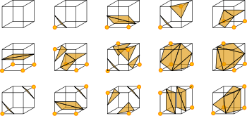
Mesh generation: Marching cubes on GPGPu
marchingcubes.glcs:
Input: the gridpoints with mark ‘0’ or ‘1’.
For each cube in parallel do:
1.According to the bordering state, the unique indices of edges(triangle vertex) are created and saved in an array in the buffer.
2. According to the gridpoints mark(0 or 1), apply Marchingcubes to cut the cube. The index is saved as a binary nummer from 0 to 255 in the buffer.
1
2
3
4
5
6
7
8
9
10
11
12
9
10
11
12
13
14
15
16
17
18
19
20
Each Cube:
1
2
3
4
5
6
7
8
9
10
11
12
Binary number
Indices of the 12 edges(vertex of triangle)
Notes:
I apply Marchingcubes algorithm to generate dense mesh. I choose this algorithm because it can be done in parallel in compute shader.
In the marchingcubes.glcs, we check each voxel and do two things:
Firstly, According to the bordering state, the unique indices of edges(triangle vertex) are created and saved in an array in the buffer.
We should notice that the triangle vertex must occur in the middle of the edge, so the index of edge is also the index of triangle vertex.
Here I give two examples, when checking the blue cube which is in the left down side corner of bbox ,12 new edges should be created according tobordering state.And its adjacent voxels are also refreshed but these edges. So when checking the yellow cube, the first 4 edges should be updated by blue voxel, and only 8 new edges need to be added to the array.
And it doesnt matter which voxel should be handled at fisrt.
Secondly, According to the gridpoints mark(0 or 1), apply Marchingcubes to cut the cube. The index is saved as a binary nummer from 0 to 255 in the buffer.
We can see for each voxel, there are 13 int type numbers are saved in the array. The first 12 numbers are the edge Indices,the last one is the binary number of the current cube.

Slide 34
Mesh generation: Marching cubes
triangles.glcs:
Input: the array of all cubes.
For each cube in parallel do:
1. According to the binary number for each cube, the three vertices of each triangle can be saved in an array using lookup table.
2. For each vertex, use an array to save related triangles info.
Each Triangle:
1
2
3
Indices of the three vertices
Each triangle Vertex:
1
2
3
4
……..
15
16
Num of tri
Indices of related triangles
Notes:
In triangles.glcs file, the input is the previous array. And we check each cube in parallel and do:
According to the binary number for each cube, the three vertices of each triangle can be saved in an array using lookup table.
And Then For each vertex, use an array to save related triangles info.The first 16 int type number are the Indices of related triangles for each vertex. The last one record how many triangles are related.
All these operations can be done using atomic add function from OpenGL Shading Language.

Slide 35
Mesh generation: Marching cubes
Normals.glcs:
For each vertex do:
1.Calculated the normals of each related triangle to get the vertex normal.
Notes:
And then in the normals.glcs file,
We Calculated the normals of each related triangle to get the vertex normal.And it is also saved in an array in the buffer.

Slide 36
Mesh generation: Marching cubes
Each Vertex:
1
2
3
4
……..
15
16
Num of related triangles
Indices of related triangles(int type)
Each Triangle:
1
2
3
Indices of the three vertices(int type)
Each Vertex:
x
y
z
Position of the vertex(float type)
Vertex positions, Vertex normals, Triangles
Render
Notes:
Now we conclude that based on the previous steps ,we can get for each vertex the indices of related triangles and we have the each triangles with the Indices of the three vertices.
And every vertex xyz position.
So we can on the gpu get the Vertex positions, Vertex normals, Triangles
Finally ,we can directly draw them .and the data even doesn’t need to be transmitted to the cpu.

Slide 37
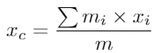
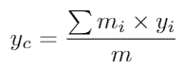
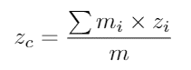
Estimation of center of mass
We assume that the density of the captured person is uniform, so the center of gravity of the captured human body is estimated by calculating the center of mass of all voxels using formulas:
where (x_{c},y_{c},z_{c}) is the center of mass, and x_{i}, y_{i} and z_{i} are the position of the current voxel on the x, y and z axes.

Slide 38
Recording point cloud
The functionality of Recording :
Point cloud is saved in the binary file format “.lbypc”.
“.lbypc” includes camera position, transformation matrix, point positons and color information.
The functionality of Replaying :
“.lbypc” Files are loaded from folder continuously. Recording and replaying speed depend on voxelization or mesh generation speed, not time.
Notes:
slow motion

Slide 39
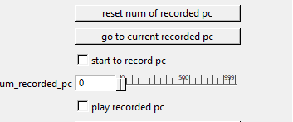
Recording point cloud
Users can record up to 1000 frames while devices are on. New content can overwrite old content while recording.
Users can replay the recorded content while devices are off. When replaying, the user can view the point cloud, volume, or mesh.

Slide 40
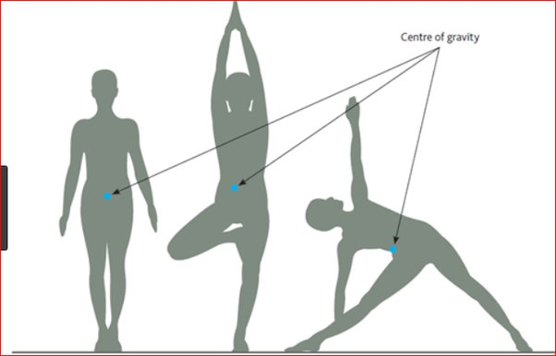
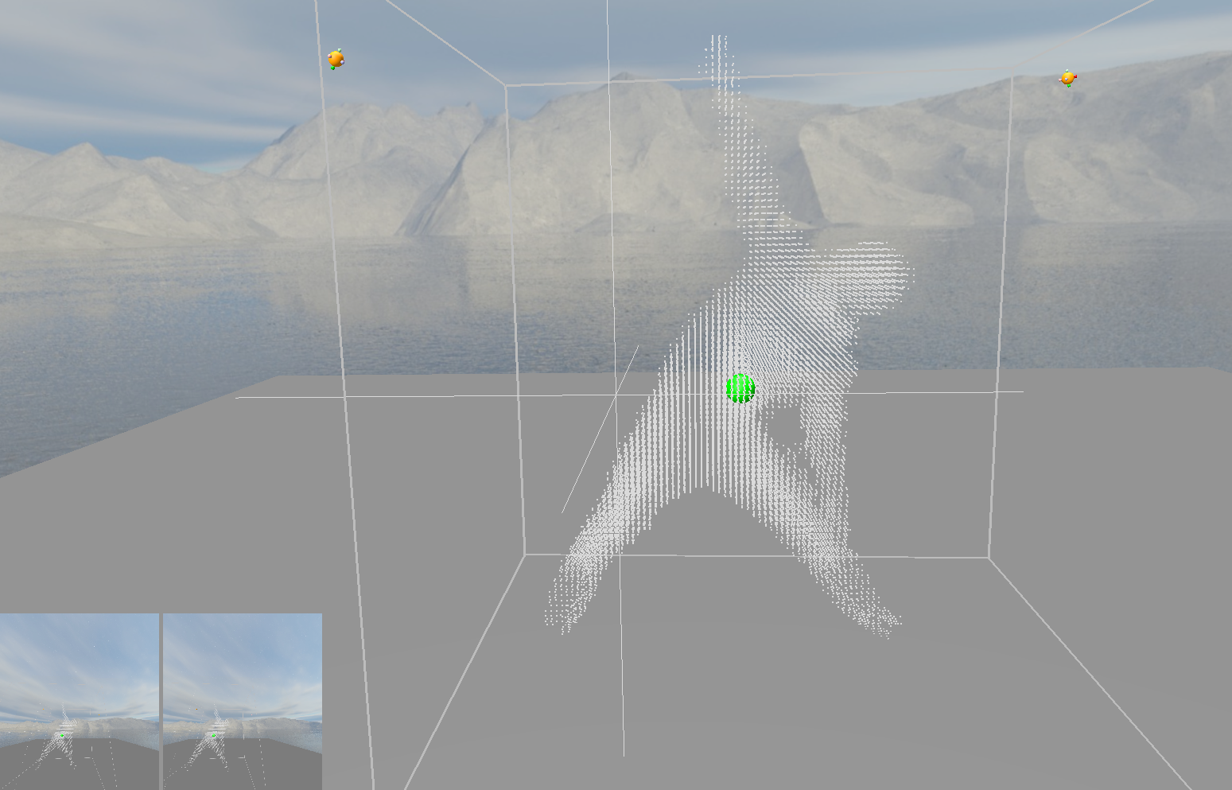
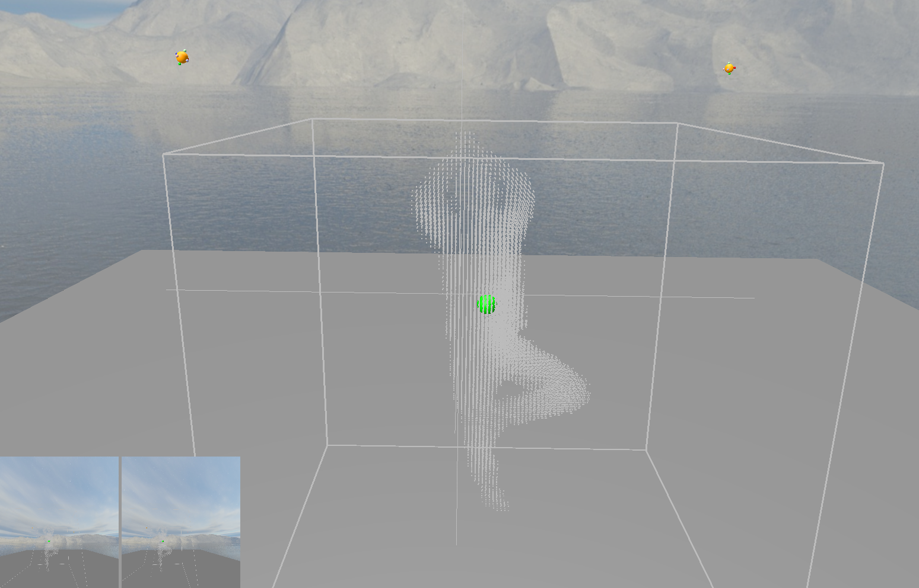
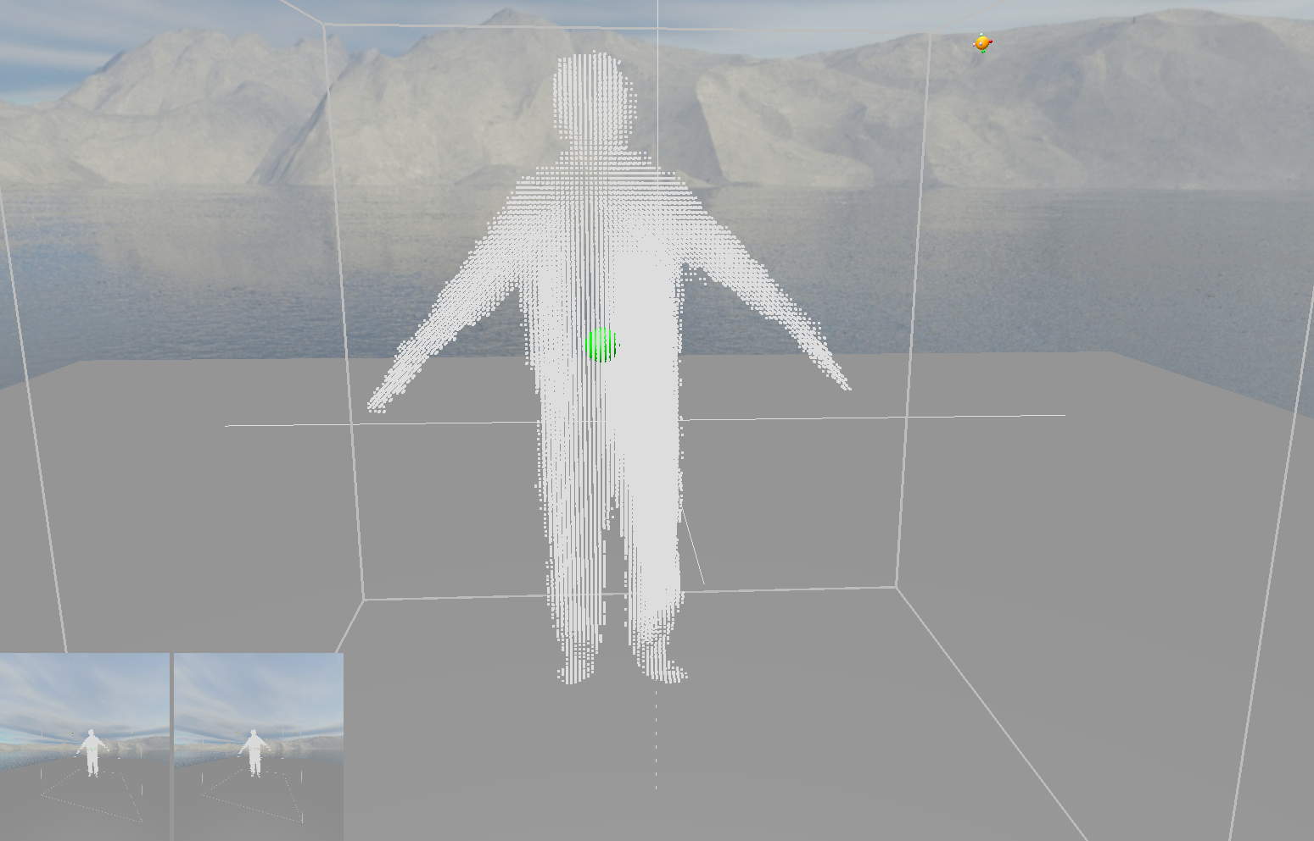
Evaluation of center of mass using our method
Notes:
.................
...................
……………….
…………..
I have tested that when I stand on one foot, no matter what pose it is, the vertical line of the center of gravity will fall on my foot.
glEnable(GL_BLEND);
glDrawArrays(GL_POINTS, 0, (GLsizei)boxes.size());
glDisable(GL_BLEND);

Slide 41
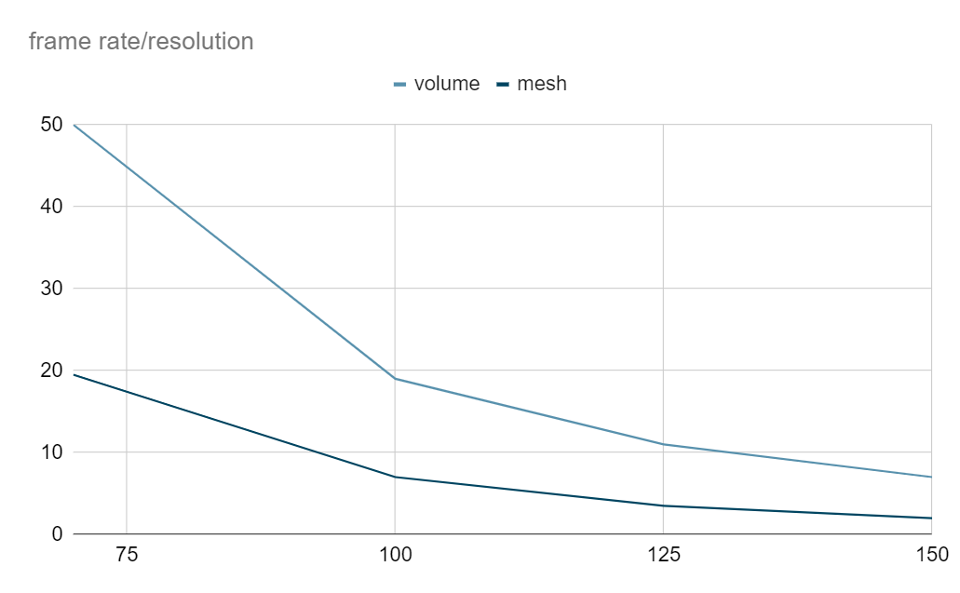
Rperformance
Hardware:A desktop PC with i9-9900k and RTX 2080 Ti.
Notes:
………………
………………
………………
Monitor performance function

Slide 42
5.Demo

Slide 43
limitation
Watch the video!

Slide 44
Limitations:
1.A lack of fusion algorithm(TSDF) to generate mesh.
Reason: The mapping and undistortion function in Azure kienct SDK are not open source. The user cannot directly use the depth stream to do further work.
2.The quality of point cloud is not good.
How to solve: use more cameras or more professional infrared cameras to do 3D reconstruction.
Future work:
Implement some interactions between users and the captured person.
Add color texture.

Slide 45
Thanks!
Questions

